Slide 1
Wisconsin Energy
Workforce Consortium
September 18, 2019

Slide 2
Agenda
Welcome | Safety Share | Introductions
WI Dept of Workforce Development Updates
CEWD Update
Midwest Meeting Summary
Construct Program
WEWC Business Update
Lunch
Strategic Planning Update & Survey Review
Working Session
Closing

Slide 3
Agenda
WiFi for the Day:
Powernet
Password: blueskies

Slide 4
Wisconsin Energy Workforce Consortium
Membership responsibilities
Make every effort to attend all meetings (if unable to attend, please send a representative)
Serve as an active member by providing input to the Consortium efforts
Adhere to requests and deadlines associated with the Consortium’s strategic areas of focus
Participate on at least one taskforce/project
Notes:
Jim/Ron…

Slide 5
Wisconsin Energy Workforce Consortium
Member Survey – if you have not participated please do so now from your smart phone, tablet or pc.
We will be using this data today!
Survey Link:
https://www.surveymonkey.com/r/2019_WEWC_Member_Survey
Notes:
Jim/Ron…

Slide 6
Wisconsin Energy Workforce Consortium
Welcome | Safety Share | Introductions
Ron Graber

Slide 7
Department of Workforce Development
Employment and Training Update
Becky Kikkert
Director, Office of Special Initiatives
Wisconsin Energy Workforce Consortium
Fitchburg, WI
September 2019

Slide 8
Oakhill Job Center Project
Notes:
September 2018 implementation
October 2018 press event
DWD funds used in part to fund the startup of this Job Center
Services provided
Labor market information
JCW registration
Referrals
Assessment
Employment plan development
Case management
Referrals
Program enrollment
Participating partners/programs:
DET—Job Service ( WDA 10 and 11)
DET-Registered Apprenticeship
DET-Office of Veteran Employment Services (WDA 10 and 11)
DVR-WDA 10
WDBSCW-WDA 10, Title 1

Slide 9
Oakhill Job Center Project
Notes:
Services provided
Labor market information
JCW registration
Referrals
Assessment
Employment plan development
Case management
Referrals
Program enrollment
Participating partners/programs:
DET—Job Service ( WDA 10 and 11)
DET-Registered Apprenticeship
DET-Office of Veteran Employment Services (WDA 10 and 11)
DVR-WDA 10
WDBSCW-WDA 10, Title 1

Slide 10
Oakhill Job Center Project
Division of Employment and Training
Job Service
Apprenticeship
Veteran Services
Division of Vocational Rehabilitation
Division of Adult Institutions
Oakhill Correctional Institution
Reentry Unit
Bureau of Technology Management
Employment and Training Association (EATA)
Windows to Work
Notes:
Participating partners/programs:
DET—Job Service ( WDA 10 and 11)
DET-Registered Apprenticeship
DET-Office of Veteran Employment Services (WDA 10 and 11)
DVR-WDA 10
WDBSCW-WDA 10, Title 1

Slide 11
Taycheedah Job Center Project
Notes:
September 2019 implementation
September 2019 press event
DWD funds used in part to fund the startup of this Job Center
Services provided
Labor market information
JCW registration
Referrals
Assessment
Employment plan development
Case management
Referrals
Program enrollment
Participating partners/programs:
DET—Job Service ( WDA 4 and 5)
DET-Registered Apprenticeship
DET-Office of Veteran Employment Services (WDA 4)
DVR-WDA 4
Windows to Work WDA 5
DOC Social Workers & Educational Staff

Slide 12
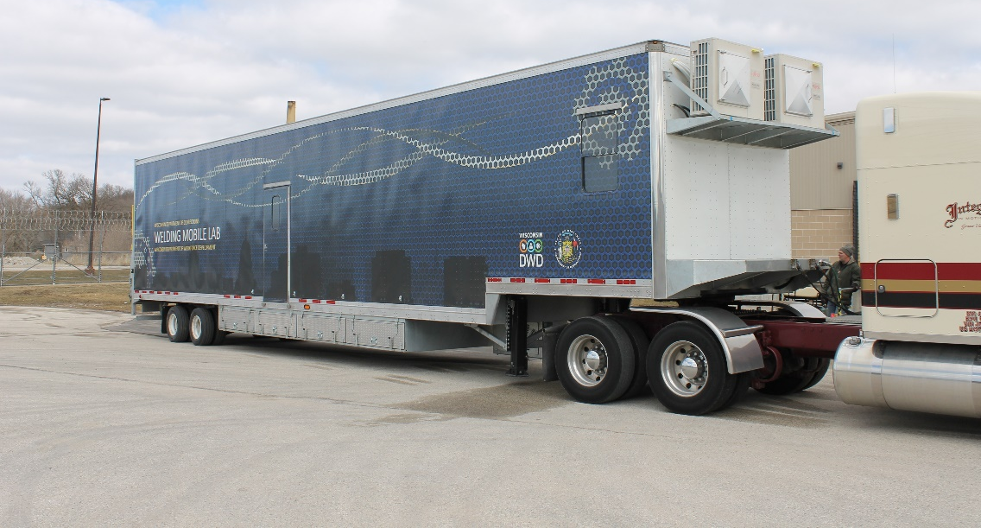
DWD/DOC Collaboration
Notes:
Mobile training lab
DOC previously received funds through Wisconsin Fast Forward for first lab, and is procuring 2 additional labs this year provided through DWD.
This will offer expanded services throughout the state.
This is the welding mobile lab that is currently at the Taycheedah Correctional Institution in Fond du Lac.
They held their first cohort of eight female inmates receiving training on the mobile lab this past two months with them all receiving
certificates in welding from the local technical college – Moraine Park.
Starting in January 2020 – this mobile lab will move to Kettle Moraine Correctional Institution for the calendar year and then return back to
Taycheedah for 2021.

Slide 13
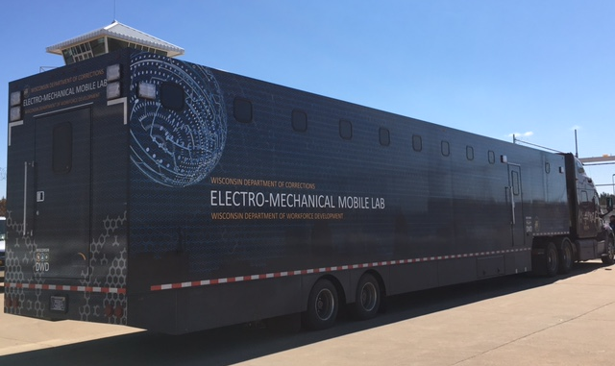
DWD/DOC Collaboration
Notes:
Mobile training lab
DOC previously received funds through Wisconsin Fast Forward for first lab, and is procuring 2 additional labs this year provided through DWD.
This will offer expanded services throughout the state.
This is the electro-mechanical mobile lab that is currently at the Jackson Correctional Institution in Black River Falls.
They will be holding their first cohort participating in the training for a certification from the local technical college – Western Tech.
Starting in January 2020 – this mobile lab will move to New Lisbon Institution for the calendar year and then return back to
Jackson Correctinal for 2021.

Slide 14
DWD/DOC Pre-apprenticeship & Registered Apprenticeship Opportunities
Bureau of Apprenticeship Standards
Currently nearly 40 registered apprentices in DOC institutions
Offering new opportunities with the creation of pre-apprenticeship programs and certifications
Training programs and instructional programs completed at DOC facilities; sometime through work-release programming
Notes:
Bureau of Apprenticeship Standards
Currently nearly 40 registered apprentices in DOC institutions
Offering new opportunities with the creation of pre-apprenticeship programs and certifications
Training programs and instructional programs completed at DOC facilities; sometime through work-release programming
Examples of apprenticeship program includes: welding, industrial maintenance, carpentry, mechanical drafting, horticulturist, culinary, and building maintenance

Slide 15
Future Correctional Job Center Opportunities
Currently, Oakhill and Taycheedah are open
Next, by the end of the calendar year, two additional facilities
For 2020, anticipating three to four additional facilities to come on board
Notes:
Currently, Oakhill and Taycheedah are open
Next, by the end of the calendar year, two additional facilities (Milwaukee Women's Correctional Center & Robert E. Ellsworth Correctional Center in Sturtevant)
For 2020, anticipating four additional facilities to come on board (Racine Correctional Institution, Prairie du Chien Correctional Institution,
Chippewa Valley Correctional Treatment Center, and John C. Burke Correctional Center)

Slide 16
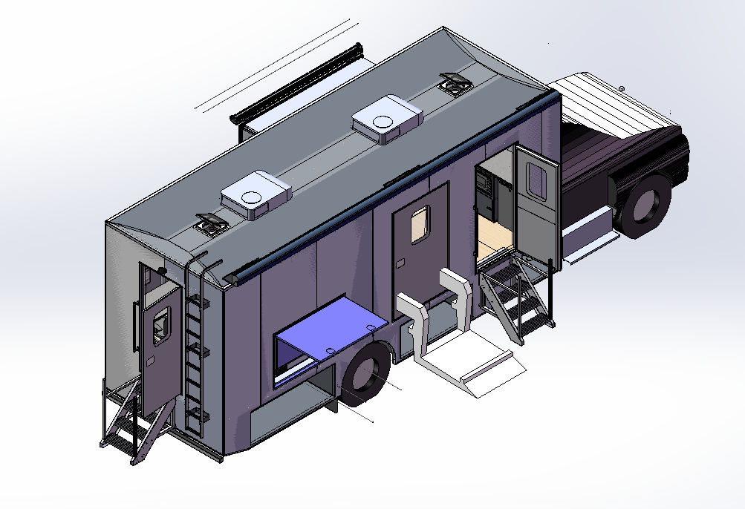
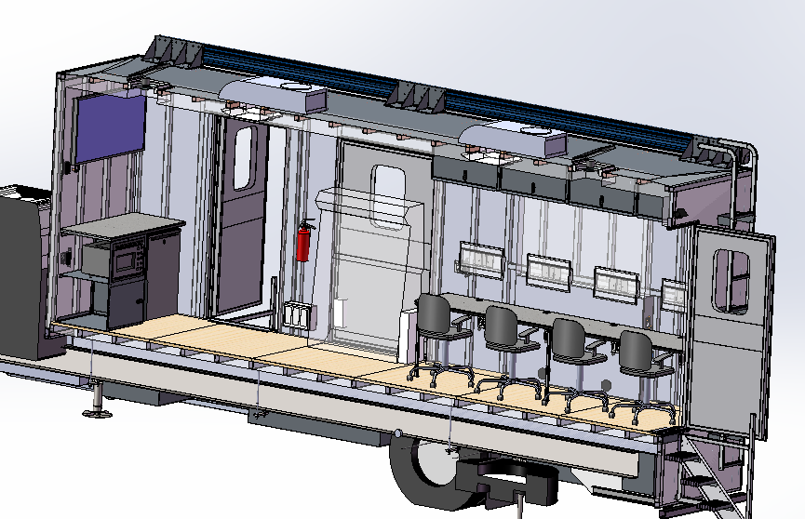
Mobile Career Lab
Notes:
The Department of Workforce Development's Mobile Career Lab visits communities throughout Wisconsin
delivering workforce resources and services to individuals and businesses.
The Mobile Career Lab assists those who may have challenges accessing workforce services,
employers or businesses who have a training or hiring need,
and partners who could use additional resources offered by the Mobile Career Lab.
The Mobile Career Lab offers the following resources/services:
Job Search Assistance: Resume Review, Help with Job Applications, Improving Interview Skills, etc.
Individual or Group Career Exploration
Connections to Local Employers and Job Openings
Re-employment Services to Unemployment Insurance Claimants
Labor Market Information and Resources for Employers and Job Seekers
Workshops to Assist Job Seekers with Resumes, Interview Techniques, and other Work Search Skills
Technical Assistance and Liaison Services to Employers in Recruitment and Workforce Retention Planning
Veteran Job Service Assistance
Workforce Displacement Job Service Assistance

Slide 17
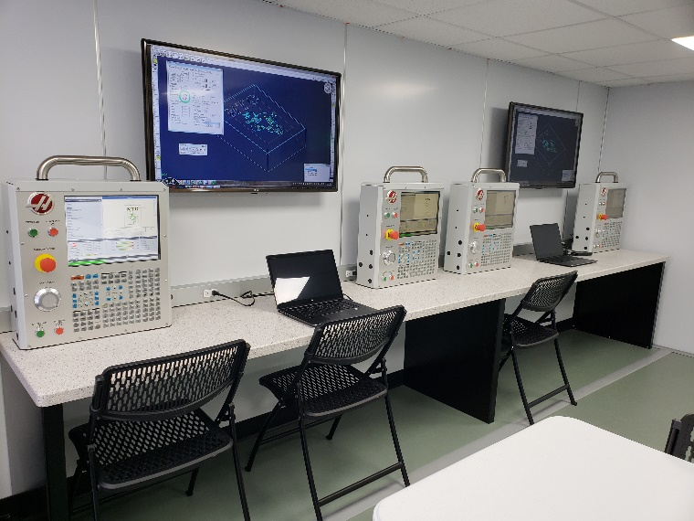
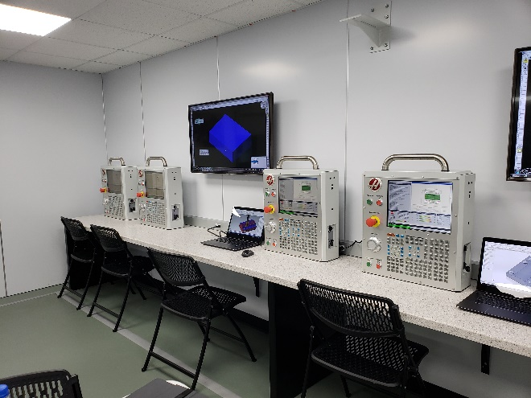
Mobile Sector Centers
Notes:
(KM- I don’t think you need bullets on the slide, you can just talk about things. The images are enough)
Mobile Sector Center – Advanced Manufacturing
Creating “semi” sized mobile lab for businesses, schools, workforce boards to use
Partnering with Northcentral Technical College (NTC),
North Central Wisconsin Workforce Development Board and Northwest Wisconsin Workforce Investment Board
Throughout this Fall, the Mobile Sector Center will be at four different school district through November, as well as three employers.

Slide 18
Reentry – Fidelity Bonds
Provides bonds for anyone not eligible for commercial bonding
No cost to employers
Protects the employer in case of any loss of money or property due to employee dishonesty
Employee must have job offer/hired before bond can be issued
Contact local Job Center to connect with bonding coordinator: JobCenterofWisconsin.com/directory
dwd.wisconsin.gov/bonding/
Notes:
Provides bonds for anyone not eligible for commercial bonding
No cost to employers
Business insurance policy that protects the employer in case of any loss of money or property due to employee dishonesty via theft, forgery, larceny, or embezzlement
Upon application, the bond is issued to the employer free-of-charge
Employer or job applicant must contact the Job Center closest to them for the local bonding coordinator and must receive a job offer with a scheduled date or hire
https://dwd.wisconsin.gov/bonding/

Slide 19
Reentry – Work Opportunity Tax Credit (WOTC)
Federal income tax credit designed to help people gain on-the-job experience and better employment outcomes
Hiring individual from targeted groups who have significant barriers to employment
Credits are subtracted from accrued tax
New online application/management system: webapps.dwd.state.wi.us/ewotc/
Assistance can be obtained at your local Job Center or at dwd.wisconsin.gov/dws/bjs/taxcredit
Notes:
Federal income tax credit designed to help people gain on-the-job experience and better employment outcomes
KM- I won’t get into specific numbers in this presentation: Employers can claim up to 40% of the first $6,000 in qualified first-year wages for a maximum credit of $2,400 per new hire
Must complete the IRS Form 8850 within 28 days of the job start date and send to https://webapps.dwd.state.wi.us/ewotc/
Assistance can be obtained at your local Job Center

Slide 20
Department of Workforce Development
Employment and Training Update
Andrew Phelps
DVOP, Office of Veteran Employment Services
Wisconsin Energy Workforce Consortium
Fitchburg, WI
September 2019

Slide 21
Office of Veteran Employment Services (OVES)
Office of Veteran Employment Services
Advance veterans into the workforce through targeted business engagement and effective employment services.
Notes:
The Mission of DWD’s Office of Veteran’s Services –
Advance veterans into workforce through targeted business engagements and effective employment services.

Slide 22
OVES Staff and Services
Local Veterans Employment Representatives (LVERs):
Conduct outreach to employers to assist veterans in gaining employment
Coordinate seminars and workshops for employers to highlight the benefits of hiring veterans
Facilitate veteran employment and training services
Capacity Builder
Increase Public Awareness
Promote the skills and Values of Veterans
Notes:
LVERS conduct outreach, facilitate employer workshops, build the capacity by connecting services with partners and ensure veteran priority of service is maintained within the job centers.

Slide 23
OVES Staff and Services
Disabled Veteran Outreach Program Representatives (DVOPs):
Work one-one with Veterans to assess their skill sets
Provide resume, job search and job readiness assistance
Work with local agencies to provide other supportive services
Outreach within local community to find Veterans
Help Veterans to transition from military jobs to civilian occupations
Notes:
DVOPS conduct comprehensive assessments and develop individual employment plans to overcome barriers to employment.

Slide 24
DWD/DOC Collaboration
Office of Veterans Employment Services
Staff going into prisons to meet with military veterans set to release in next 60-90 days.
DOC provides lists
Case management is established while folks are still incarcerated
Notes:
Office of Veterans Employment Services
Staff going into prisons to meet with military veterans set to release in next 60-90 days.
DOC provides lists
Case management is established while folks are still incarcerated

Slide 25
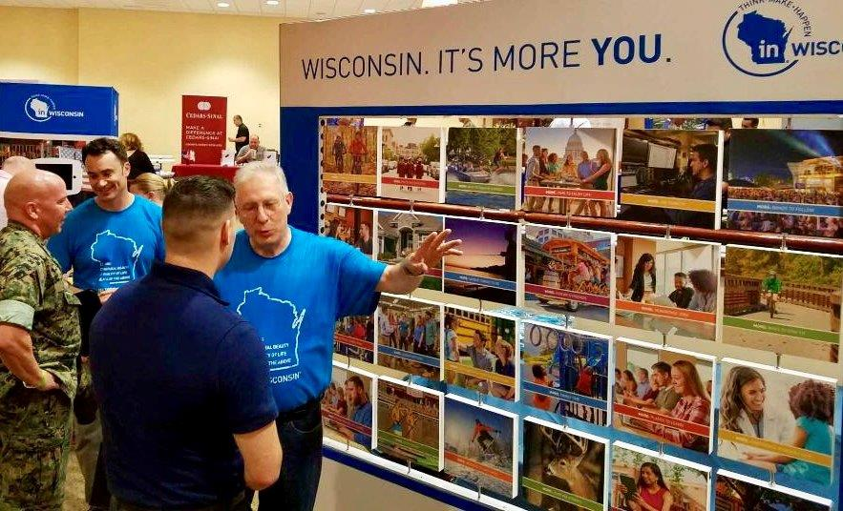
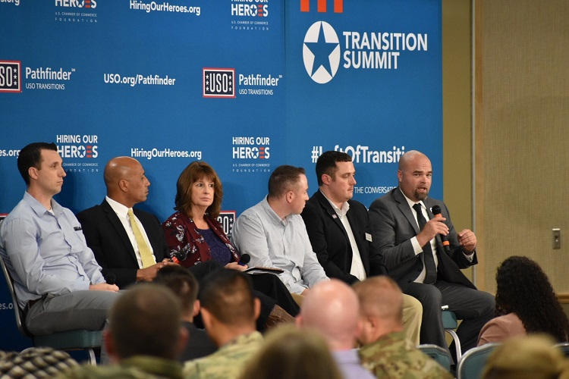
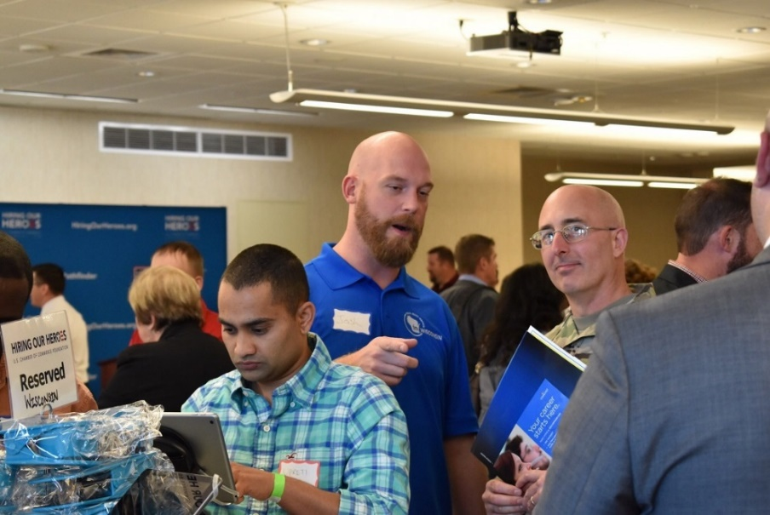
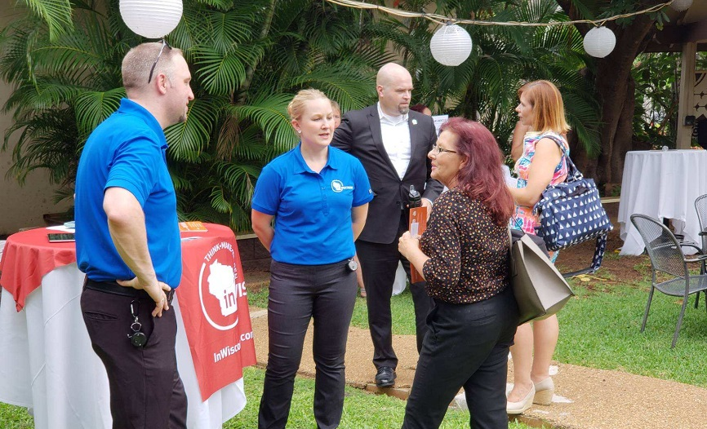
Veteran Recruitment Transition Summits
Notes:
DWD Staff attended
Promoting the benefits offered to Veterans in Wisconsin (how Wisconsin provides so many benefits to veterans)

Slide 26
Vets Ready Program
New employer recognition program
Highlighting employers who are supportive of veterans in their organization
Employers will apply
Awardees will be showcased by DWD as a “Vet Ready” employer
Program will launch around Veterans Day 2019

Slide 27
Questions?

Slide 28
WEWC Meeting
CEWD Update
September 18, 2019

Slide 29
CEWD Contractor Members
Dynetek Solutions (new)
INTREN
InfraSource
MasTec
Michels
Pike
Power Team Services, including KS Energy (new)
Premier Power Maintenance
Notes:
Two new contractors have joined CEWD – Dynetek Solutions headquartered in South Carolina and Power Team Services, which includes KS Energy, Volt Power and Southeast Connections.

Slide 30
NEW! Average Retirement Rate Messages
Media sources continue to cite an inaccurate percentage that 50% of the energy workforce will retire in 10 years. When asked about retirement in the industry, refer to these messages.
Total Energy Workforce
12% of the total energy workforce is ready to retire at any point
Retirements are forecast at 2.7% a year for the next 10 years
This amounts to 25.5% that may be eligible for retirement in the next five years
Workforce in Key Jobs
10% of the workforce in key jobs (line workers, plant /field operators, skilled technicians and engineers) is ready to retire at any point
Retirements are forecast at 2.4% a year for the next 10 years
This amounts to 22% that may be eligible for retirement in the next five years and 34% that may be eligible for retirement in the next 10 years
For both populations, the percentages are below those for non-retirement attrition and shows the trend toward “normal” retirement for the industry.
Source: CEWD’s 2019 Gaps in the Energy Workforce Survey

Slide 31
New Initiatives
Technical Training Community of Practice for technical training leads in member companies – contact Ray@cewd.org to join
Energy Industry Fundamentals for New Employees developed for use in new employee orientations – contact Valerie@cewd.org for more information
Members are asked to submit a short What CEWD Means to Me video for a montage at the 2019 Annual Summit – contact Beth@cewd.org for more information

Slide 32
2019 Key Dates
Careers in Energy Week – October 14-18
CEWD Annual Summit
November 12/13, Crystal City Marriott, DC area
CEWD National Forum
November 14 (8 am-noon), Crystal City Marriott

Slide 33
CEWD Contractor Members
Dynetek Solutions (new)
INTREN
InfraSource
MasTec
Michels
Pike
Power Team Services, including KS Energy (new)
Premier Power Maintenance
Notes:
Two new contractors have joined CEWD – Dynetek Solutions headquartered in South Carolina and Power Team Services, which includes KS Energy, Volt Power and Southeast Connections.

Slide 34
Wisconsin Energy Workforce Consortium
Midwest Meeting Summary
BJ | Troy | Joan | Ron

Slide 35
Midwest Region Meeting Hosted by Xcel Energy June 19-20, 2019

Slide 36
State Energy Workforce Consortia
WA
ND
MN
OR
WI
NY
CT
SD
MI
NE
IA
IL
NV
VA NC
CA
CO
KS
MO
KY
AZ
NM
OK
AR
SC
GA
LA
FL
Regional Consortium
Existing Consortium
Planned Consortium

Slide 37
Measuring Progress Task Force
March 2018 – Board convened task force to determine how the industry can measure progress on workforce initiatives
November 2018 – results presented and
pilot companies were named
March 2020 – completion of pilots and
roll out to membership
9

Slide 38
What Matters Most for Today and the Future
0.00% 10.00%
Having enough diverse applicants apply for your jobs
Retention of the knowledge lost through attrition
20.00% 30.00% 40.00% 50.00% 60.00%
70.00%
80.00%
Attracting job seekers to your company Building partnerships in education and the
community
Attracting job seekers to your industry
Creating / implementing a strategic workforce plan
Employability skills of applicants for your jobs
Longer-term (2-5 years) retention of new hires
Availability of resources
Retirement of employees
Measuring progress on talent development efforts
Most Important today
Most Important in 5 Years
8

Slide 39
What Matters Most to Companies In Workforce Development
Readiness
Creating / implementing a strategic workforce plan
Availability of resources
Measuring progress on talent development efforts
Employee Development and Retention
Building the Talent Pipeline
Recruiting and Hiring
Attracting job seekers to industry
Building partnerships in education and the community
Employability skills of applicants for your jobs
Attracting job seekers to your company
Having enough diverse applicants apply for your jobs
Retention of knowledge lost through attrition
Longer term (2-5 years)
retention of new hires
Retirement of employees

Slide 40
What are the Game Changers for this
Region? For your state?
How have you aligned your HR and Company Policies with your strategic workforce priorities?
How do you coordinate workforce priorities across the organization?
What metrics do you use for each stage of Workforce Development?
Readiness

Slide 41
What career awareness initiatives is your company engaged in?
What demographics do you target?
What skill building and work based learning opportunities does your company provide?
How does your company communicate energy education pathways?
Is there a sufficient supply in your state
for critical jobs?
Do you know the supply from NEEN schools?
Building the Talent Pipeline

Slide 42
Where are the NEEN Schools?
11
68
37
31
58

Slide 43
Student Pipeline
Midwest Region K-12 Student Population
0% 3%
3%
1%
White Students
Black Students
12%
Hispanic Students
14%
Asian or Asian/Pacific Islander Students
American Indian/Alaska Native Students
Hawaiian Nat./Pacific Isl. Students
67%
Two or More Races Students
Data from National Center for Education Statistics - http://nces.ed.gov/ccd/elsi/
61

Slide 44
We Energies
Work Based Learning Programs
March 18, 2019

Slide 45
The Issue
Inability to retain experienced/qualified employees in the Milwaukee Area
Delayed Emergency/Customer Response
Volume per responder
Less fully qualified responders – additional responders
Increased cost of doing business
Employee training ground under less then ideal situations
More safety related incidents
Personal safety
“Unique” driving environment (Volume, “technique”, etc.)
Theft
Employee frustration/dissatisfaction
Acknowledge situation – it is different
Attrition

Slide 46
Work Based Learning Programs
In partnership with MPS, MATC & IBEW L2150
Design Youth Apprenticeship
Preparing students for the opportunity to become a designer for the gas and electric distribution system
The Designer occupation includes a four year apprenticeship at We Energies
Requires 2 year Associate Degree
Represented by IBEW L2150
Field Worker Internship
Primarily preparing students to become Line Mechanics at We Energies
Also provides exposure to other occupations including:
Milwaukee Underground Cable Splicer
Equipment Operator
Gas Distribution Worker

Slide 47
Work Based Learning Programs
Common to both programs
Continuing support from MPS administration and coordinators
Required parent involvement
Introductory Parent meeting – signed agreement
Throughout the program, a parent will be invited in to address an issue (typically related to home life)
Mentor Program
Design students – related to work they are doing
Field students – more focused on life mentoring

Slide 48
Partnership, Collaboration, and Coordination:
Colleges & Tech Schools (MEC)
Existing HS Internship Programs
Industry Partners (XE)
Legacy Staff
High Schools
Parents
Integrated Curriculum:
Energy Industry Fundamentals (EIF)
Character Development
Financial Literacy
Health & Wellness
OSHA/Safety
Support Services:
Transportation
Counseling
Mentorship/Ambassadors
Academic Assistance:
Scholarship Application Assistance
Financial Guidance
Mentors & Tutors
College Prep
Career Readiness & Planning:
College and Tech School Visits
Industry Exposure and Mentors
Pre-Employment Test Prep
Job Shadowing
31

Slide 49
2015
2016
2017
2018
2019
Benchmarking trip to APS.
XE, MEC, Mpls and St. Paul Public Schools
Summer pilot.
First fall cohort at 4 schools
Energy Ambassador program established
First interns hired
First cohort to enter Lineworker program
Technical College Engagement
First cohort dropped out of Lineworker program
Second cohort to enter Lineworker program.
More interns hired
Second cohort to graduate from lineworker program
3 FTEs
5 Interns
3 Contractors

Slide 50
Outreach to K12

Slide 51
Energy Education for
Educators
Four two day workshops held at partner college sites
Heavy focus on evolving industry
Numerous teaching resources
Instructional lessons and kits
Tours of industry sites Overview of college programs
Lessons on Solar, Energy and
Efficiency
Adding Wind, Hydro and Energy Industry evolution

Slide 53
Industry and Education- What’s New?
Amber Fogarty, Energy Talent Pipeline Specialist
94

Slide 54
Energy Industry
Fundamentals

Slide 55
How do you connect your recruiters to talent pipeline efforts and to workforce priorities?
What is the role of Workforce Development in recruiting?
Are your pipelines providing adequate
diversity?
What credentials do you recognize from pipeline initiatives?
How are your hiring managers
engaged in workforce development?
How do your ERGs support recruiting and hiring efforts?
Recruiting and Hiring

Slide 56
Total Attrition vs Total Hires
Total Company
10%
9%
8%
7%
6%
5%
4%
3%
2%
1%
0%
% of Employees
Non-retirement Attrition
Retirements
Hires
Respondents only

Slide 57
Diversity Hires (Respondents Only)
Average Percentage of Diversity Hires
FEMALE MINORITY
13
11
FEMALE NON-MINORITY
15
17
MALE MINORITY
20
17
MALE NON-MINORITY
52
55
0
10
20
30
40
50
60
2016 Hires 2014 Hires
Preliminary – Not for Distribution

Slide 58
Diversity & Inclusion
Webinar Series
New alliances -
CSMLearn
New resources
Integration with EEI’s Diversity and Inclusion initiative
D & I National Template

Slide 59
Investor Owned Utility Veteran Hires
(Respondents Only)
Average Percentage of Veterans Hires
Nuclear
24
23
Engineers
9
14
Technicians
26
27
Plant Operator
17
27
Line worker
13
16
0 5 10
2016 Veteran Hires
15 20
2014 Veteran Hires
25
30
Preliminary – Not for Distribution

Slide 60
Troops to Energy Jobs
New alliances
New resources
Registered veterans
and companies
Troops to Energy Jobs
Employers
22

Slide 61
How is Technical Training integrated
into workforce development?
Does your company partner with education institutions for career development and upskilling of existing employees?
How does your company focus retention strategies on stage of life and career aspirations?
How does your company track non- retirement attrition?
Employee Development
and
Retention

Slide 62
Total Company
Non-retirement Attrition – Retention Issues
(Overall, of the total number of employees exiting for non-retirement reasons, 4 out of 10 leave the
company within the first 5 years and the problem is greatest in Gas T&D where it is 7 out of 10)
2016
100%
75%
68%
71%
50%
47%
47%
41%
42%
36%
36%
25%
21%
20%
22%
12%
17%
10%
9%
0%
Total Company
Electric T&D
Gas T&D
Non-nuclear
Generation
>10 YOS
Nuclear
Generation
<5 YOS
6-10 YOS
Respondents only
Preliminary – Not for Distribution

Slide 63
Generations in the Utility Workforce
45%
40%
35%
30%
25%
20%
15%
10%
39%
38%
37%
35%
34%
33%
29%
30%
29%
29%
23%
2%
2%
1%
0%
0%
Gen Z
Millenials Gen X Boomers 2016 2016 Key Jobs 2016 Engineers
2014
Source: CEWD 2017 Gaps in the Energy Workforce Survey
51

Slide 64
Drivers of Knowledge Transfer
Retirements
~25% over 10 years
Knowledge
Management
Labor Budget Management

Slide 65
Knowledge Transfer Toolkit
Toolkit Components | Socialization Process
Master Process Description Retirement Planning Discussion Interview Guide Transfer Plan Document | Posted in Managers Toolbox Announcement to All Supervisors HRG Meetings with Client Groups Periodic Reminders to HRGs + Client Groups

Slide 66
CEWD Strategic Workforce Planning Metrics
Readiness: Workforce Development Assessment Tool
Employee Development and Retention
Building the
Talent Pipeline
Recruiting and Hiring
Value: Increased effectiveness of talent pipeline initiatives
Metrics:
Number of graduates
Number of applicants
from pipeline programs
Number of diverse applicants
Value: Improved candidate quality and diversity
Metrics:
Pass rates on pre- employment screening
% of diverse applicants to
hires
# of hires with industry credentials
% of hires from pipeline programs
Value: Increased employee
retention
Metrics:
Non-retirement attrition by years of service, critical jobs, demographics
Responsibility:
Responsibility:
Responsibility:
Workforce Development
Education Institutions
Human Resources
Hiring Managers
Human Resources
Management

Slide 67
Wisconsin Energy Workforce Consortium
Break

Slide 68
Wisconsin Energy Workforce Consortium
Construct Program
Dennis Bednarksi

Slide 69
Making Powerful Connections
Sept ember 18, 2019
INTREN OutPerforming. Everyday

Slide 70
Illinois workload increased due to the 2012 Energy Infrastructure Modernization Act (EIMA)
Our Challenge
Grass-roots groups, contractors and politicians supported the EIMA Bill to rebuild Illinois
Existing labor pool demographics did not reflect the communities in which the work was done
2
INTREN OOuuttPPeerrffoorrmmiinngg.. EEvveerryyddaayy

Slide 71
Int ren’s
Involvement:
Matthew Turk Met with Cornell Barnett of ComEd to Discuss the CONSTRUCT Concept
Founder Loretta Rosenmayer Supported the Concept from the Beginning
Reached out to the Unions and Contractor Community
INTREN
Answering
the Challenge
Worked with Cornell Barnett/ ComEd to Contact Social Agencies
CONSTRUCT Kick-Off 2013
INTREN has been a leader in t ime & financial support since 2013
3
INTREN OOuuttPPeerrffoorrmmiinngg.. EEvveerryyddaayy

Slide 72
The Components
Create a common, standardized curriculum: utilities, contractors, unions
Provide participant recruiting, screening and training: community not-for-profit agencies
Provide Job Shadowing and Career Day: Participating companies and unions
Job Shadowing
4
IINNTTRRENEN OOututPPeerrfforormmiingng.. EEvveerryydadayy

Slide 73
A Partnership of
Stakeholders
GOAL:
Better prepare local, diverse candidates to enter union jobs
Construction &
Engineering Firms and Unions
Social Service Agencies
Utility Companies
5
Job Shadowing
INTREN OOuuttPPeerrffoorrmmiinngg.. EEvveerryyddaayy

Slide 74
Stakeholders 2019
Career Day
6
INTREN OOuuttPPeerrffoorrmmiinngg.. EEvveerryyddaayy

Slide 75
Overview
Now in its 7th year, CONSTRUCT is a program powered by an alliance of companies, social service agencies and labor unions.
The 9-week program offers up to 130 diverse students annually job readiness and life skills training, information and guidance necessary to compete for good- paying, entry-level jobs in construction-related fields.
The curriculum now has two tracks: Construction & Skilled Trades and Project Management/ Planning/ Admin
7
IINNTTRRENEN OOututPPeerrfforormmiingng.. EEvveerryydadayy

Slide 76
In the Classroom & Job Shadowing
8
INTREN OOuuttPPeerrffoorrmmiinngg.. EEvveerryyddaayy

Slide 77
The Schedule
Home Agency
Friday Sessions
Two Track Schedule
Construction and Skilled Trades
Project
Management/ Planning/ Admin
9 IINNTTRRENEN OOututPPeerrfforormmiingng.. EEvveerryydadayy

Slide 78
Schedule- 9 Weeks
10
IINNTTRRENEN OOututPPeerrfforormmiingng.. EEvveerryydadayy

Slide 79
11
IINNTTRRENEN OOututPPeerrfforormmiingng.. EEvveerryydadayy

Slide 80
Behind
the Scenes and More…
Locator Training
Microsoft Office Tools
Math Skills Training
Energy Efficiency
Solar Training
Engineering Overview
Union Roundtable
12
IINNTTRRENEN OOututPPeerrfforormmiingng.. EEvveerryydadayy

Slide 81
Data Collection
13
INTREN OOuuttPPeerrffoorrmmiinngg.. EEvveerryyddaayy

Slide 82
Company
Module Overviews
Company Overview
5 or 6 per day
Entry level positions Requirements
Job Shadowing
1 or 2 days on site
Personal Protective Equipment Expectations – participant and company Matching
HR Panel
Interview Preparation Interviewing Skills Expectations
14 IINNTTRRENEN OOututPPeerrfforormmiingng.. EEvveerryydadayy

Slide 83
Unite Agencies with best practices in Education
Determine curriculum for participants in:
Reading and Math
Employment Testing
Interviewing Skills
Test Taking
Communication Skills
Employability Skills
Provide program support on site at each Agency
Educational Consult ant
15
INTREN OOuuttPPeerrffoorrmmiinngg.. EEvveerryyddaayy

Slide 84
Educational
Consult ant
Employment Testing Training:
Targeted instruction for passing the CAST Test
Targeted instruction through NCCER for passing Employment Tests in
Construction Math and Union Tests
Increased days of academic instruction
16
INTREN OOuuttPPeerrffoorrmmiinngg.. EEvveerryyddaayy

Slide 85
Graduates Employe d
2019 CONSTRUCT: 129 Graduates
96 Employed (74%)
Placed by Agency: 63
Hired by Stakeholders: 33
2018 CONSTRUCT: 95 Graduates
80 Employed (84%)
Placed by Agency: 80
Hired by Stakeholders: 26
Graduation
17
INTREN OOuuttPPeerrffoorrmmiinngg.. EEvveerryyddaayy

Slide 86
Next St eps
Extend the Program to Utility Companies in Other Regions
To Date: INTREN has
presented CONSTRUCT to Ameren and BGE
Job Shadowing
18
INTREN OOuuttPPeerrffoorrmmiinngg.. EEvveerryyddaayy

Slide 87
CONSTRUCT GRADUATES: Dexter Allison, Sr. and Dexter Allison, Jr.
INTREN OOuuttPPeerrffoorrmmiinngg.. EEvveerryyddaayy

Slide 88
Wisconsin Energy Workforce Consortium
WEWC Business Update
Heather Dyer

Slide 89
Update
Board of Director Members:
Vern Peterson – Executive Sponsor
Ron Graber – Chair
BJ Rauckman – Vice Chair
Troy Schneider - Treasurer
Began collecting Dues in December 2018 –
Next cycle will begin December 2019
Currently collected $45,500
6 Investor Owned
1 Utility Association
11 Contractors – 3 additional in process
All voting designation forms received except for the 3 contractors in process.
Current WEWC Roster of 84 Individuals

Slide 90
Wisconsin Energy Workforce Consortium

Slide 91
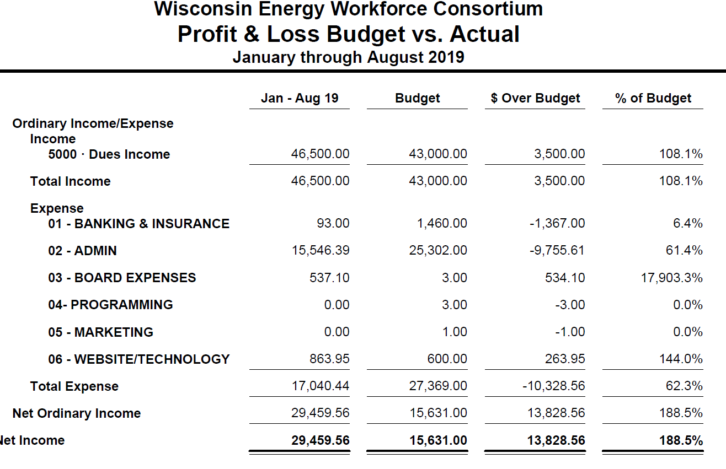
Wisconsin Energy Workforce Consortium

Slide 92
Update
Website URL
http://www.wi-energyworkforce.org
Voting Member Designation forms have been mailed
Please respond at WEWC Admin (wewc@morgandata.com)

Slide 93
Questions?

Slide 94
Wisconsin Energy Workforce Consortium
Lunch

Slide 95
Wisconsin Energy Workforce Consortium
Strategic Plan Update
2020-2024
Ron Graber

Slide 96
Vision
The Wisconsin energy industry is comprised of a qualified and diverse workforce of engineering, craft, and technical workers to provide safe, reliable and efficient energy.

Slide 97
Mission Statement
The mission of the Wisconsin Energy Workforce Consortium is to identify and develop solutions that Consortium members use to meet the current and future workforce needs of the energy industry in Wisconsin. This will be accomplished through active engagement and partnerships with investor-owned, municipal and cooperative energy companies, contractors, energy and contractor associations, state economic development, workforce development, and education partners.

Slide 98
Key Areas of Focus
The WEWC Strategic Plan is organized around the four strategic pillars used in the CEWD Strategic Plan:
Career Awareness
Education
Workforce Planning
Structure & Support

Slide 99
Career Awareness
Objective: Create awareness among targeted populations of the critical need for a skilled energy workforce and the opportunities for education that can lead to employment and career progression.

Slide 100
Career Awareness
Strategies:
Build awareness of careers and career progression in energy among Wisconsin’s K-12, undergraduate, and veteran population.
Increase awareness of career progression in energy in our perspective workforce.
Increase the diversity of the applicant pool for skilled energy positions.

Slide 101
Education
Objective: Implement clearly defined education solutions that link industry recognized competencies to employment opportunities and advancement in the energy industry.

Slide 102
Education
Strategies:
Partner with educators to identify the basic foundational skills, knowledge and abilities required to create a diverse pool of qualified workers for energy jobs.

Slide 103
Education
Strategies cont’d:
Assess the skill impact of new technologies and integrate into education pathways.
Develop mentorships in the industry.

Slide 104
Workforce Planning
Objective: Balance the supply and demand for a qualified and diverse energy workforce.

Slide 105
Workforce Planning
Strategies:
Validate state workforce demand numbers to verify key in-demand jobs for career awareness and strategic planning purposes.
Analyze supply data for key energy programs from educators to verify educational system capacity to meet energy workforce needs.

Slide 106
Workforce Planning
Strategies cont’d:
Measure workforce development initiatives to determine impact on critical skill and workforce gaps.
Retention and development of existing industry workforce.

Slide 107
Structure and Support
Objective: Organize and manage the WEWC to maximize its positive impact on national, state, and individual company initiatives.

Slide 108
Structure and Support
Strategies:
Effectively manage and drive change through Wisconsin Energy Workforce Consortium projects and initiatives.
Revisit the Task Forces
Revisit the flow of standing agendas
Revisit organization structure – who does each utility bring to the table

Slide 109
Structure and Support
Strategies cont’d:
Membership
Funding
Partnerships/External – State, DPI, Education, etc
Assess the impact of energy workforce needs on State workforce policy

Slide 110
Structure and Support
Strategies cont’d:
Create mutually beneficial alliances with organizations that support and advance WEWC initiatives.
Maintain the WEWC as a self-sustaining operating structure that includes governance, management, and financial processes.

Slide 111
Current Membership
Utility/Co-op | Contractors | Educators | Government
Alliant Energy | Henkels & McCoy | Blackhawk | Dept of Public Instruction
ATC | Hooper | Chippewa Valley | Dept of Workforce Development
Madison Gas & Electric | Intercon | Gateway | Economic Development Corp
WE Energies | Intren | Moraine Park | Technical College System
WI Electric Co-op Association | KS Energy | NWTC | Workforce Development Association
WI Public Service | Meade | Milwaukee Area Tech | Workforce Investment Board
Xcel | Michels | Southwest Tech
 | MJ | WI KEEP
 | MP Systems
 | NPL
 | Q3

Slide 112
Executive Committee
Sue Clausing - WEC Vern Peterson – WEC (Exec Sponsor)
Lindsey Drake - Alliant BJ Rauckman – Xcel (Vice Chair)
Matt Flannigan – MG&E Troy Schneider – Michels (Treasurer)
John Glynn – WEC Joan Turba - NWTC
Ron Graber – Alliant (Chair)
Mike Herro - Xcel Beth Britt - CEWD
Amy Kox – NWTC Heather & Christopher Dyer – MDS
Annette Krutz - WEC

Slide 113
Industry Game Changers
Fuel mix is changing
Emerging markets - CNG batteries/alternative fuel vehicles
Focus on compliance and pending regulation
Increased demand for natural gas service
Fewer internal employees and more contractors
Infrastructure upgrades – Modern reliability project: undergrounding/ renewing distribution projects
Employability skills
Increasingly competitive labor markets

Slide 114
Industry Game Changers
Attrition & Retention
Technology changes that will drive new skill sets
Impact of centralized generation versus decentralized
Work culture - need to be more flexible, adaptive and innovative
Generational mix
Employment longevity not as attractive
Work flexibility

Slide 115
WI Workforce Challenges
Low Unemployment Rate
Lack of awareness of energy career opportunities
Lack of qualified engineers
Industry perception
Attracting strong diverse candidates
Lack of qualified technical instructors
Passing pre-employment testing
Passing physical ability testing(climbing poles)
Lack of interviewing skills
High School graduates without basic skills or linear skills

Slide 116
WI Workforce Challenges
Ups and downs of hiring and work for contractors
Cross training to account for attrition and knowledge
Utility is not accustom to today’s younger labor market
Employee value proposition
Decline/Flux in # of Students entering workforce (Rural/City)
Decline in Rural Population
Increase in Hiring direct from High School
Career progression – employee wants their own progression defined

Slide 117
WEWC Accomplishments
Analyzed CEWD industry Demand Report data
Collected company specific demand data to inform CEWD’s Demand Report
Collected associated supply data from all Wisconsin Technical Colleges
Identified game changers in Wisconsin
Identified other workforce challenges
Revised a SWOT analysis for the Consortium
Strengthened areas of focus for the plan by refining our strategic objectives

Slide 118
WEWC Accomplishments cont’d
Continued collaboration with governmental, education and workforce leaders to provide additional data to the Consortium
Reviewed and further defined the structure and support model for the Consortium
Transformed the WEWC into a 501c3 in order to generate funds to support the work of the consortium
Increased consortium membership by reaching out to other energy related companies working in the state

Slide 119
Wisconsin Energy Workforce Consortium
Working Session
Taskforce Co-Chairs

Slide 120
Wisconsin Energy Workforce Consortium
2020 Consortium Meetings
January 29, 2020
May 27, 2020
September 23, 2020

Slide 121
Closing
Questions?

